Slide 1
College Essay Workshop
Presented By:

Slide 2
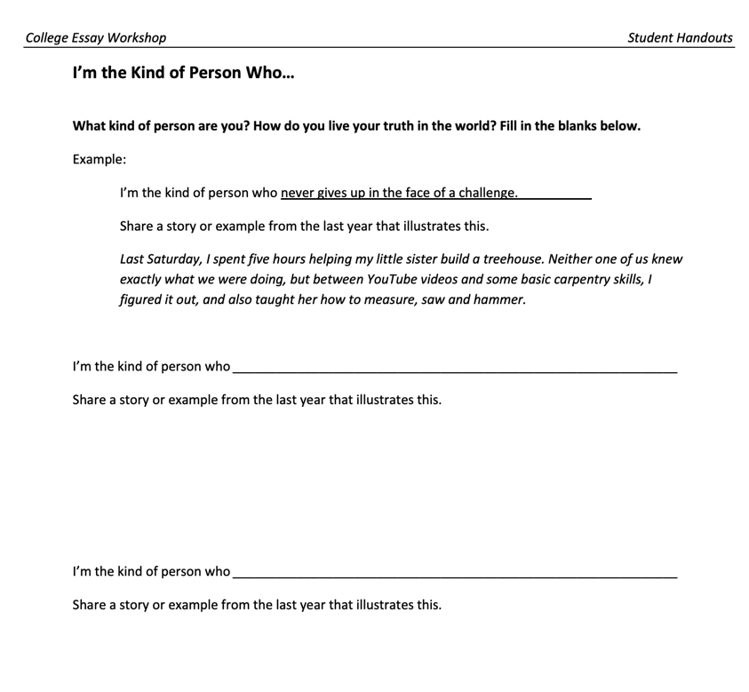
Before We Start, Complete Page 1

Slide 3
Morning Writing (Voice)
What did you do this morning, from the time you woke up….?

Slide 4
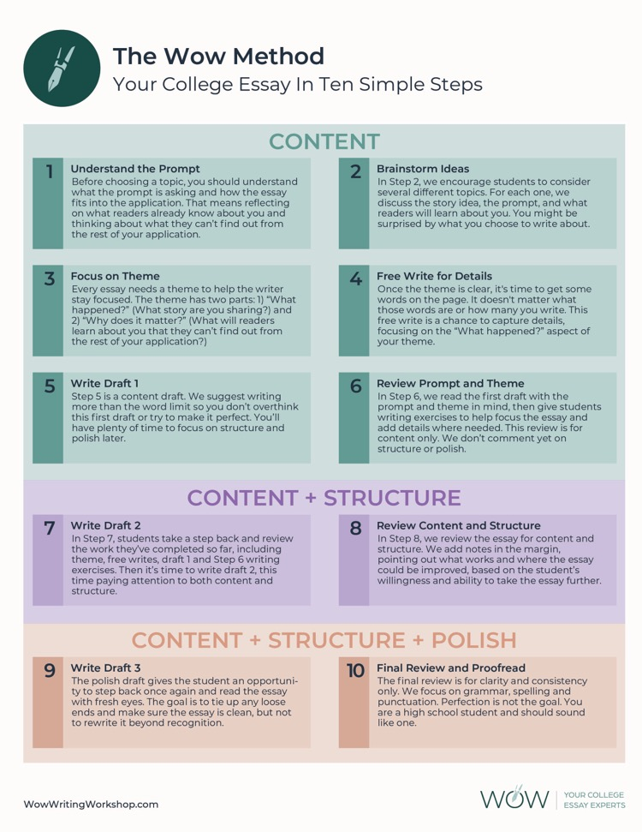
Your College Essay In Ten Simple Steps

Slide 5
Step 1: Understand the Prompt
Know Your Audience
What
Why
Who

Slide 6
Step 1: Understand the Prompt
Try to Be
Specific
Clear
Direct
Unique (YOU are unique)

Slide 7
Your voice will differentiate you!

Slide 8
Step 1: Understand the Prompt
Common Application Instructions
The essay demonstrates your ability to write clearly and concisely on a selected topic and helps you distinguish yourself in your own voice.
What do you want the readers of your application to know about you apart from courses, grades, and test scores?
Choose the option that best helps you answer that question and write an essay of no more than 650 words, using the prompt to inspire and structure your response. Remember: 650 words is your limit, not your goal. Use the full range if you need it, but don't feel obligated to do so. (The application won't accept a response shorter than 250 words.)

Slide 9
Step 1: Understand the Prompt
Some students have a background, identity, interest, or talent that is so meaningful they believe their application would be incomplete without it. If this sounds like you, then please share your story.
The lessons we take from obstacles we encounter can be fundamental to later success. Recount a time when you faced a challenge, setback, or failure. How did it affect you, and what did you learn from the experience?
Reflect on a time when you questioned or challenged a belief or idea. What prompted your thinking? What was the outcome?
Reflect on something that someone has done for you that has made you happy or thankful in a surprising way. How has this gratitude affected or motivated you?
Discuss an accomplishment, event, or realization that sparked a period of personal growth and a new understanding of yourself or others.
Describe a topic, idea, or concept you find so engaging that it makes you lose all track of time. Why does it captivate you? What or who do you turn to when you want to learn more?
Share an essay on any topic of your choice. It can be one you've already written, one that responds to a different prompt, or one of your own design.

Slide 10
Step 1: Understand the Prompt
What Happened? Why Does It Matter?
Some students have a background, identity, interest, or talent that is so meaningful they believe their application would be incomplete without it. If this sounds like you, then please share your story.
The lessons we take from obstacles we encounter can be fundamental to later success. Recount a time when you faced a challenge, setback, or failure. How did it affect you, and what did you learn from the experience?
Reflect on a time when you questioned or challenged a belief or idea. What prompted your thinking? What was the outcome?
Reflect on something that someone has done for you that has made you happy or thankful in a surprising way. How has this gratitude affected or motivated you?
Discuss an accomplishment, event, or realization that sparked a period of personal growth and a new understanding of yourself or others.
Describe a topic, idea, or concept you find so engaging that it makes you lose all track of time. Why does it captivate you? What or who do you turn to when you want to learn more?
Share an essay on any topic of your choice. It can be one you've already written, one that responds to a different prompt, or one of your own design.

Slide 11
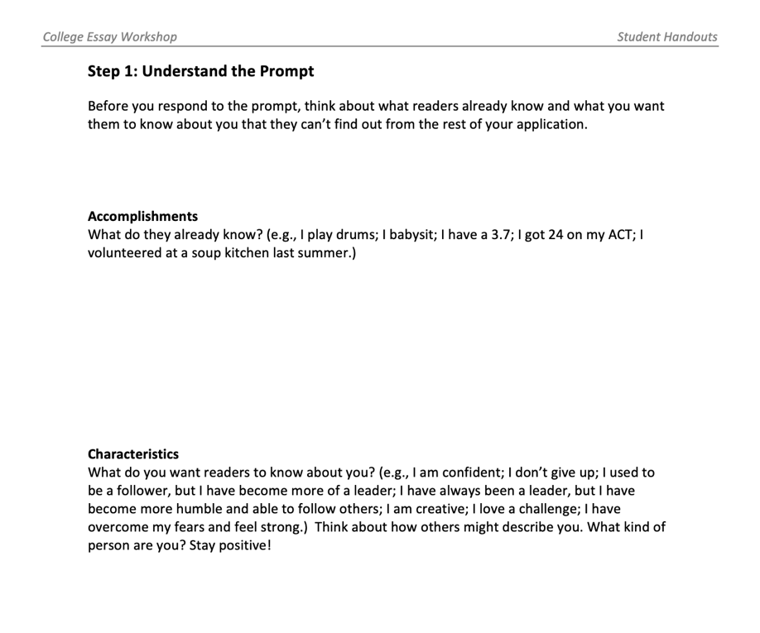
Step 1: Understand the Prompt

Slide 12
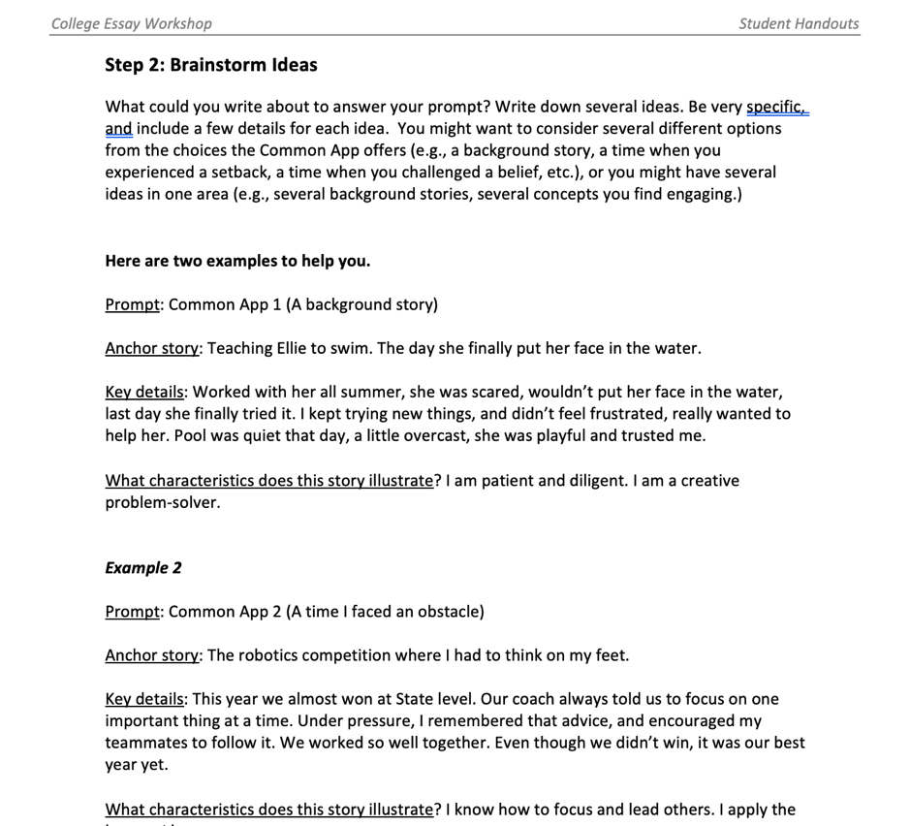
Step 2: Brainstorm Ideas

Slide 13
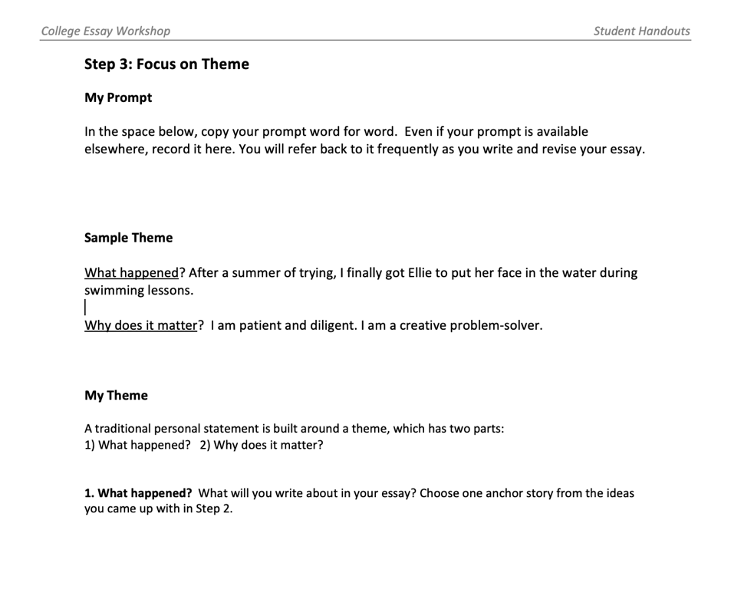
Step 3: Focus on Theme

Slide 14
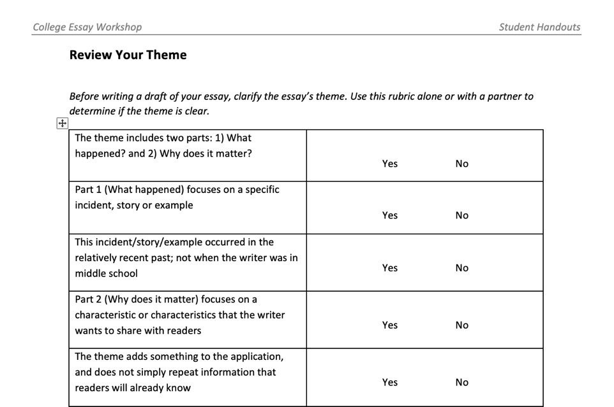
Review Your Theme

Slide 15
Step 4: Free Write for Details
Just Write, Don’t Think Too Much
Like morning writing
Write freely
Focus on what happened
This is not a first draft

Slide 16
Your College Essay In Ten Simple Steps

